Slide 1
Exploratory Data Analysis (EDA) of Netflix Shows and Movies
PRESENTED BY:
SHIKHA SHUKLA

Slide 2
Introduction
Objective: Understand the dataset and extract meaningful insights about Netflix shows and movies.
Dataset Description: Briefly describe the dataset and its origin.
Visual: Overview of the dataset structure (number of rows and columns).

Slide 3
Dataset Overview
Columns: List of all columns with brief descriptions:
Show_Id: Unique identifier for each show or movie
Category: TV Show or Movie
Title: Title of the show or movie
Director: Name of the director
Cast: List of cast members
Country: Country of origin

Slide 4
Dataset Overview
Columns: List of all columns with brief descriptions:
Release_Date: Release date of the show or movie
Rating: Age rating
Duration: Duration of the movie or number of seasons for a TV show
Type: Genre(s)
Description: Short description or summary

Slide 5
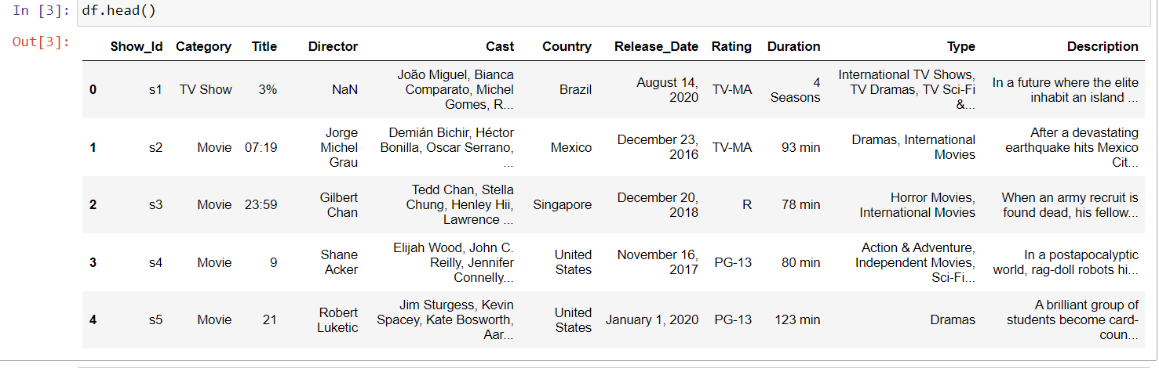
Sample Data:

Slide 6
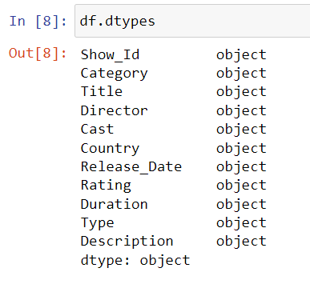

Data Inspection
Data Types:
Shape of the Dataset

Slide 7
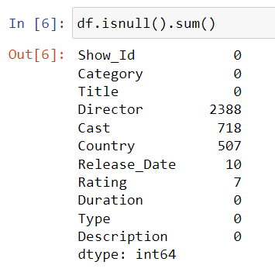
Handling Missing Values
Initial Inspection:
Columns with missing values: Director, Cast.
Strategy:

Slide 8
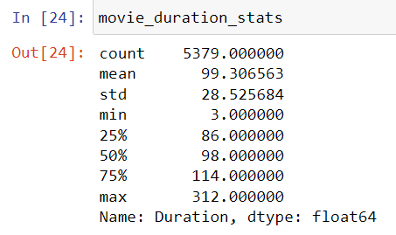
Summary Statistics
Descriptive Statistics:Duration (for Movies):
Count: The number of movies
Mean: The average duration of the movies
Standard Deviation: The measure of variation in movie durations
Min: The shortest movie duration
Max: The longest movie duration

Slide 9
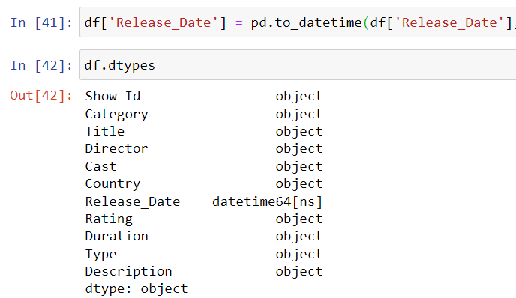
Data Cleaning
Handling Missing Values:
Replace missing values in 'Director' and 'Cast'.
Converting Data Types:
Convert 'Release_Date' to datetime format.

Slide 10
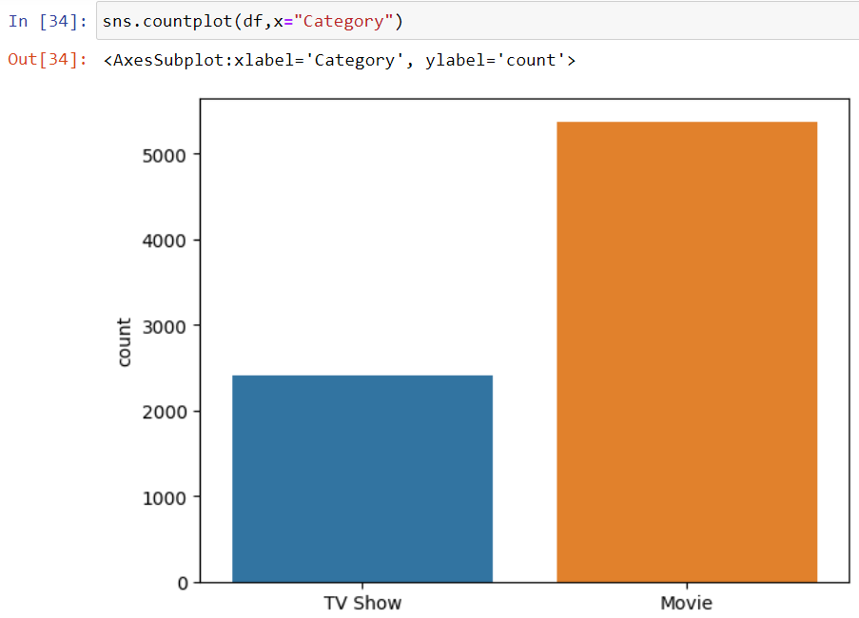
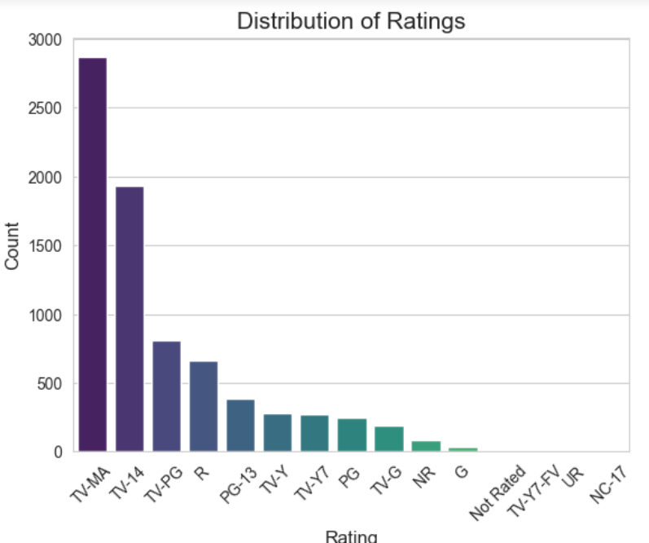
Univariate Analysis
Category Distribution:
Bar plot of TV Shows vs. Movies.
Rating Distribution:
Count of each rating category.
Visual:
Bar chart for Category distribution.
Bar chart for Rating distribution.

Slide 11
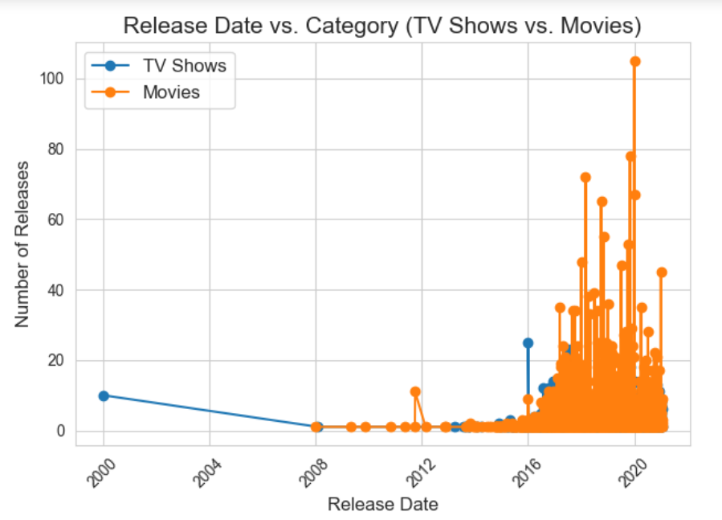
Bivariate Analysis
Release Date vs. Category:
Line plot showing the number of TV shows and movies released over time.
Country vs. Category:
Heatmap showing the distribution of TV shows and movies across different countries.

Slide 12
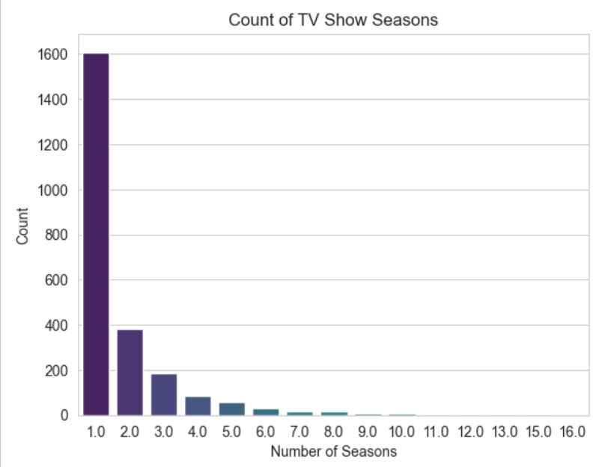
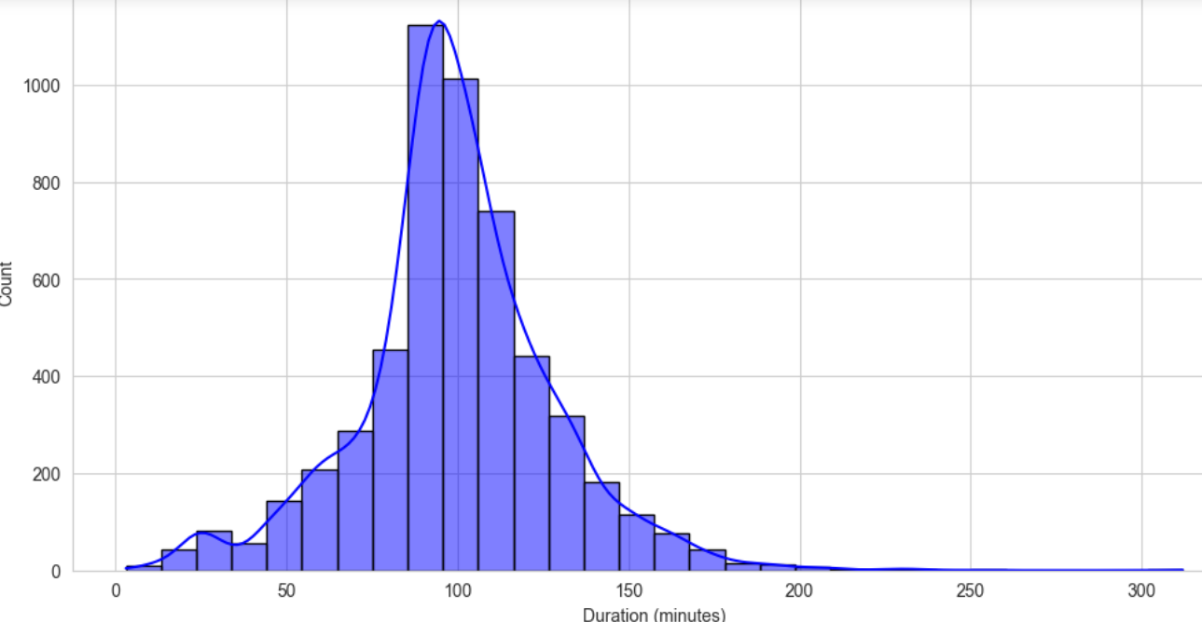
Duration Analysis
Duration Analysis:
Distribution of movie durations.
Count of TV show seasons.

Slide 13
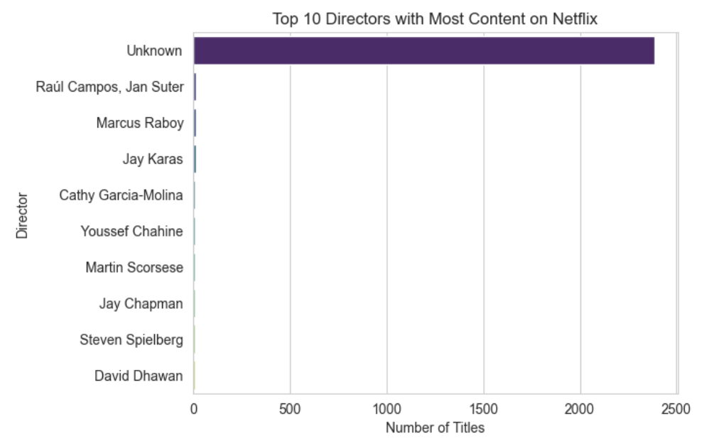
Director and Cast Analysis
Top Directors:
Bar plot of the top 10 directors with the most content.
Cast Analysis:
Word cloud of the most frequent cast members.

Slide 14
Type Analysis
Content Type Distribution:
Bar plot showing the distribution of different types of content (e.g., Dramas, Horror Movies).

Slide 15
Key Insights
Insights:Most common categories and types of content
Countries with the most content
Trends in release dates

Slide 16
THANKYOU

